Slide 1

STOCK MARKET ANALYSIS
Presented by
Chinmayee

Slide 2

Objectives:
To evaluate the performance and value of stocks and the overall market
To identify investment opportunities and market trends
To assess risk and support informed decision-making
To forecast future price movements using data and indicators
Project Summary :-
Impact:
Helps investors make smarter buy, sell, or hold decisions
Reduces investment risk through better understanding of market behavior
Improves portfolio performance and long-term wealth creation
Enhances market efficiency by reflecting available information

Slide 3
Total Market Capitalization – Shows the overall size and value of the stock market, reflecting economic strength
KPI LIST:-
Trading Volume -The total number of shares or securities traded in the market during a specific period.
Portfolio % -The proportion of total investment allocated to a specific asset, sector, or market. It helps to manage risk by avoiding overexposure.
Dividend Yield – It is a financial ratio that shows how much dividend income a company pays each year relative to its current share price.
Trade Win Ratio-Measures the effectiveness of trading strategy, Indicates consistency in generating profits.
Sharpe Ratio- The Sharpe Ratio measures the risk-adjusted return of an investment or portfolio by showing how much excess return is earned for each unit of risk taken.

Slide 4
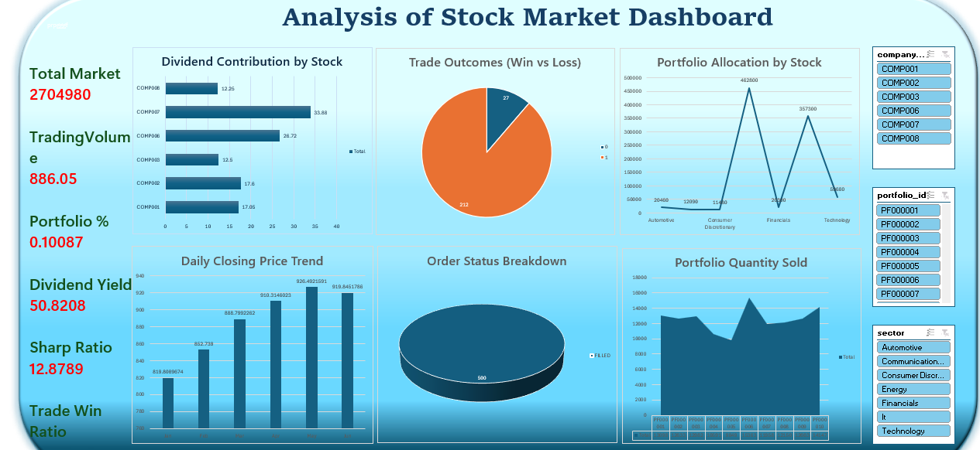

Slide 5
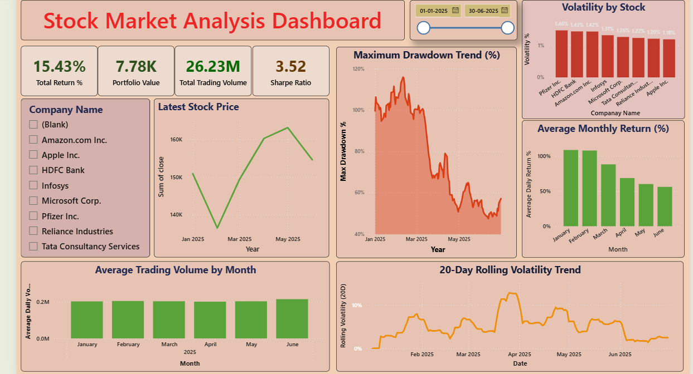

Slide 6
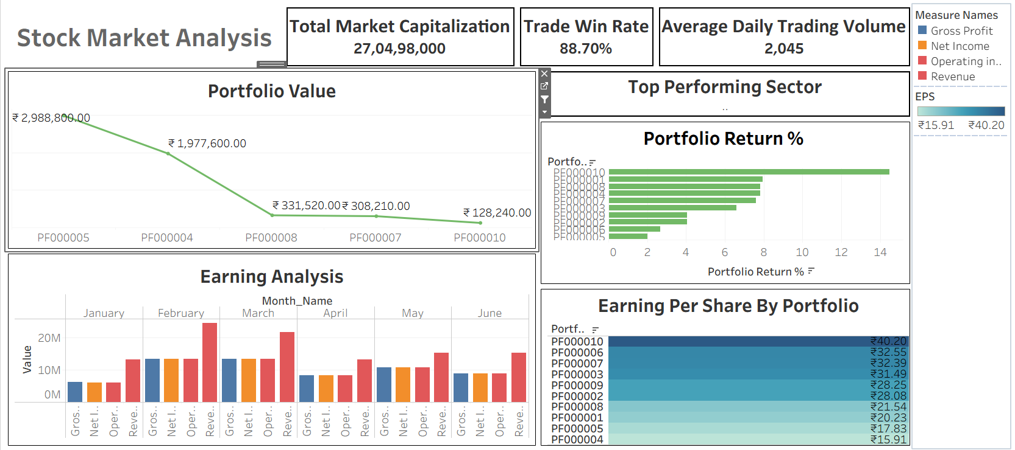

Slide 7
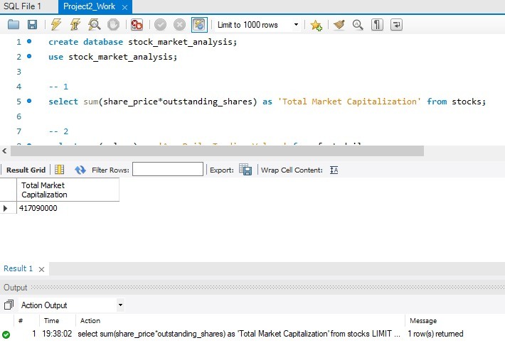
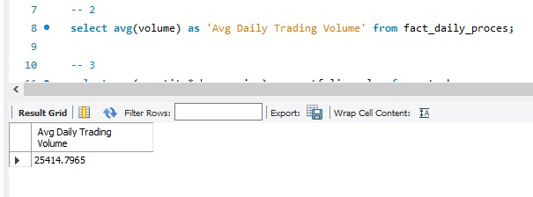

Slide 8
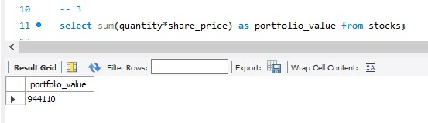
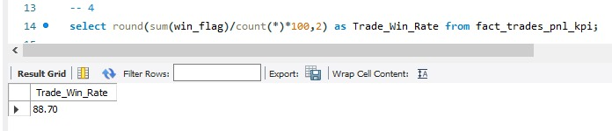
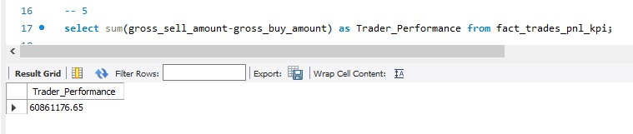

Slide 9
KEY TAKEWAYS :-
The market showed periods of high volatility, indicating increased uncertainty among investors.
Volatility varies significantly across stocks, indicating different risk profiles.
Increased trading volumes during volatile periods suggest panic buying/selling.
Investors shifted from high-risk growth stocks to stable, dividend-paying stocks.
Higher liquidity improved price discovery but also increased intraday volatility.
Low-volume stocks exhibited higher price inefficiencies.
Long-term opportunities exist in fundamentally strong stocks during corrections.
Volatility driven by macro and policy uncertainty.
Investor behaviour remains momentum-driven.
Long-term value opportunities emerge during corrections.

Slide 10
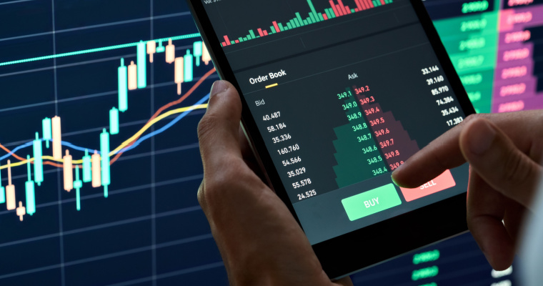
THANK YOU

